Slide 1
Building Construction Technology program
A Pictorial Analysis

Slide 2
Introduction
Technology is of the essence in construction works.
Various machines are developed to serve specific roles in construction work.
Some common equipment used in construction are backhoe tractor, helmets, hammer, tape measure and many others.
Some equipment management practices are embraced to enhance the life of service of an equipment.
The presentation showcases some building Construction Technology program

Slide 3
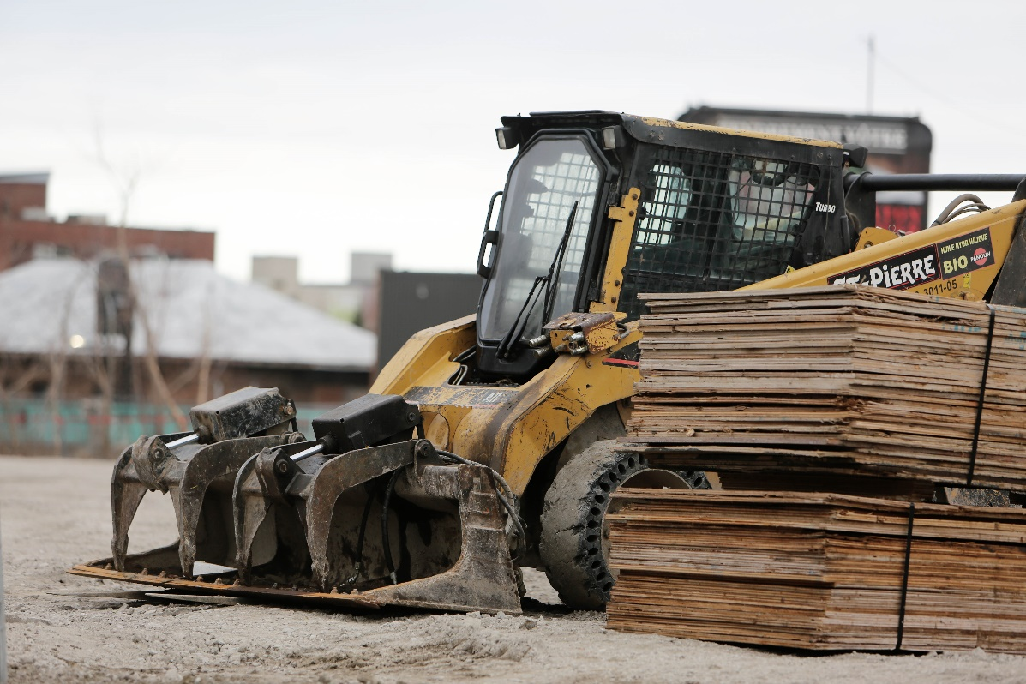
Earth Moving Tractor-Backhoe Loaders
Moving heavy construction materials
Can load materials to other tractors
Used where there is limited space especially urban engineering
Can be modified to serve a wide range of other roles
Notes:
The earth moving tractors plays revolutionary role in the building and construction. The Backhoe Loaders pictured therein, can be used in a wide of variety of tasks such as construction, small demolitions, light transportation of building materials, powering building equipment, digging holes, landscaping, breaking asphalt, and paving roads. In performing the tasks, the machine can be fitted with other parts, to enable effective performance of some other tasks. The hydraulic outrigger is used in the backhoe tractor, to help avoid it from tipping while performing other tasks. Given their small size, the tractor is widely used in urban engineering activities in areas that are too small for other heavy equipment to be used. The tractor, is often used by private home owners to aid in some construction. The advent of the tractor, was a great booster to the construction field, since it aids in ease completion of tasks, especially where earth moving is of the essential.

Slide 4

Construction Helmet
It’s a protective gear
Has sponge inside to absorb shock
Some are meant for one-off use
Other can be used for multiple breaks
Every person in the site ought to wear it
Notes:
The construction Helmet is used by any construction engineers and everybody else in the construction site. The helmets come in different sizes, worn on the head as protective gears. While some helmets are worn once, some are used to withstand multiple breaks. During a fall or impacts from a falling object, the sponge in the inside of the helmet, help reduce the impacts or injury on the user. Often, the helmets is not completely perfect, since one may still sustain injuries while on the helmets. As such, the helmet is used to mitigate adversities possible with a fall or a collision in the construction site. Any sign of damage on the helmets, implies immediate replacement of the same.

Slide 5
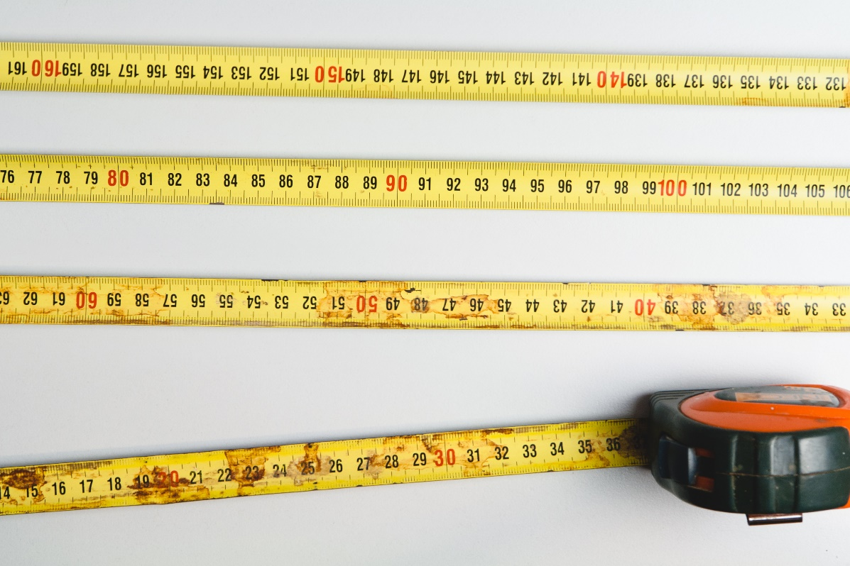
Tape Measure
A simple tool used to quantify objects and distance
It is easy and safe to use
Its foundation is the SI unit
For longer life, it should be kept clean and fit to box
It is made of durable materials
Notes:
A tape measure is very useful in taking measurement in every construction work. A tape measure is a portable measurement device used to quantify the size of an object or the distance between objects. The advent of the tape measure, is the SI unit of measurement. Tape measure is relatively safe and easy to use in the construction work, given the ease to interpret calibration. For a prolonged life, the tape measure is kept clean, and well fitted in the safety box. Many of the steel blade tapes comprise of tension-control brakes that lock the blade in place for measuring spans. Longer tapes have a crank on the side of the case to retract the cloth tape.

Slide 6
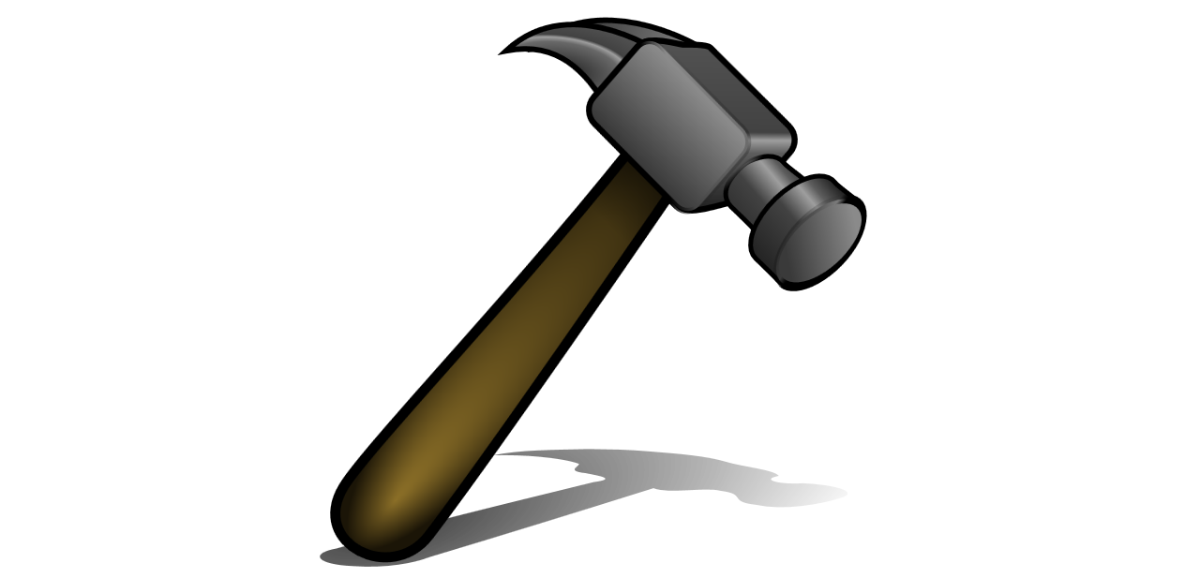
Hammer
A light tool used to hit on objects
Hammer can nail in, or pull out nails
Its major parts are handle and head
Claw bar id the most common hammer
The head is made of hard material to withstand from crack
Notes:
Hammer, is a handheld tool, that is used to strike other objects in the construction work, especially driving in nails on woods, or shaping metallic objects. There are many types of hammer, comprising of the claw hammer, which is the most common as above photo used to drive and pull out nails. The head and handle, are the major components of the hammer. Some hammers as above, have the tail, which is used to pull out nails. The heads of a hammer are made of high carbon, heat-treated steel for strength and durability. The hard materials of the hammer, help in alienating the hammer from chipping or cracking as results of repeated hits.

Slide 7
Conclusion
Technological advancements has played critical role in construction
Major equipment reviewed comprise of hammer, tape measure, backhoe tractor, and helmet.
Helmets are worn as protective gears, to reduce the injuries on the users, however they do not assure no injury-They mitigate
Tape measure is used in quantifying objects sizes
Backhoe tractor, is one of the equipment used for earthmoving during construction work.
Backhoe tractor, is often used in Urban engineering with limited spaces.

